Slide 1
Checker Solver
By: Rafael Uriostegui, Maliq Tepkhoom, Jay Woo, and Cristobal Escobar

Slide 2
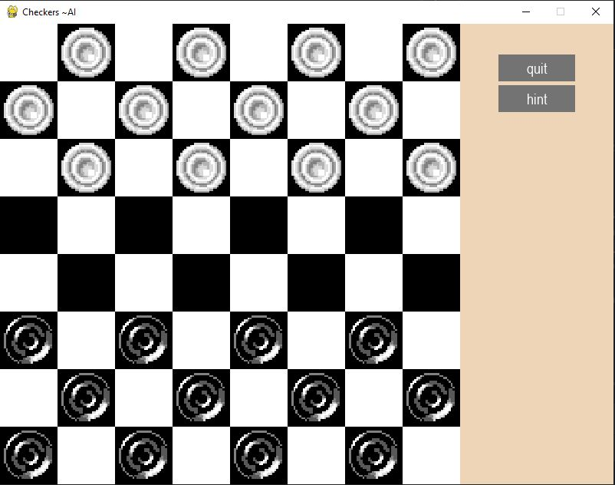
Project Goal:
Create a system that finds the quickest way to win a game of checkers
Finds the shortest path using minimax tree search algorithm
Heuristic functions that will explore available moves
Implement alpha-beta pruning to optimize technique

Slide 3
Technical Approach:
PyCharm IDE
PyGame library to render graphical elements
Python Programming Language

Slide 4
Team Roles:
Rafael implements the UI of the game. Helps with AI functionality afterwards
Maliq works on the game logic and enforces the rules
Both Jay and Cristobal implement the AI functionality

Slide 5
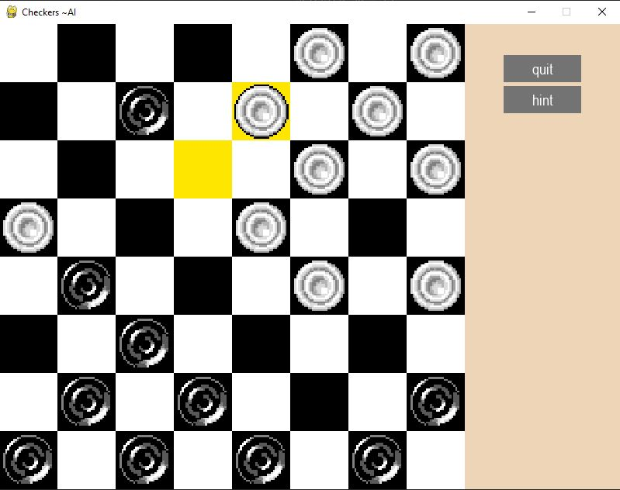
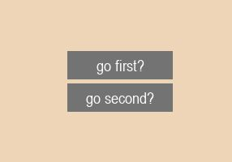
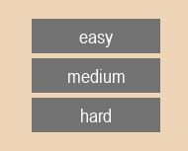
Current Project Status:
AI Hints work
Rules enforced and game win state works
Upon a tie, game crashes
Difficulty settings of AI player vs. computer and choose to go first or second

Slide 6
Future Plans:
Incorporate more sophisticated AI techniques such as Monte Carlo Tree Search
Refine heuristic evaluation functions
Implement dynamic variables of board sizes or variant rule sets

